Slide 1

Carbon Commuter
By The Ceiling Fans

Slide 2
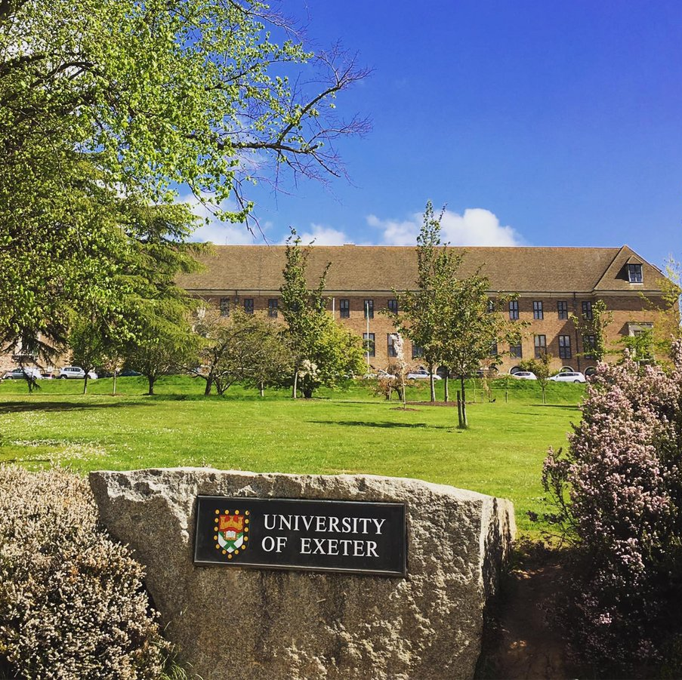
Initial Ideas Generated from the Specification
Sustainability
Relating it to Campus
Carbon Saving aspect
Gamification
Badge collection
Leaderboard

Slide 3

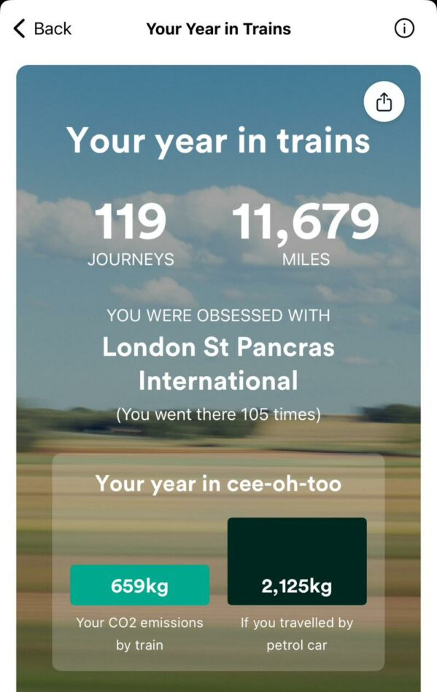
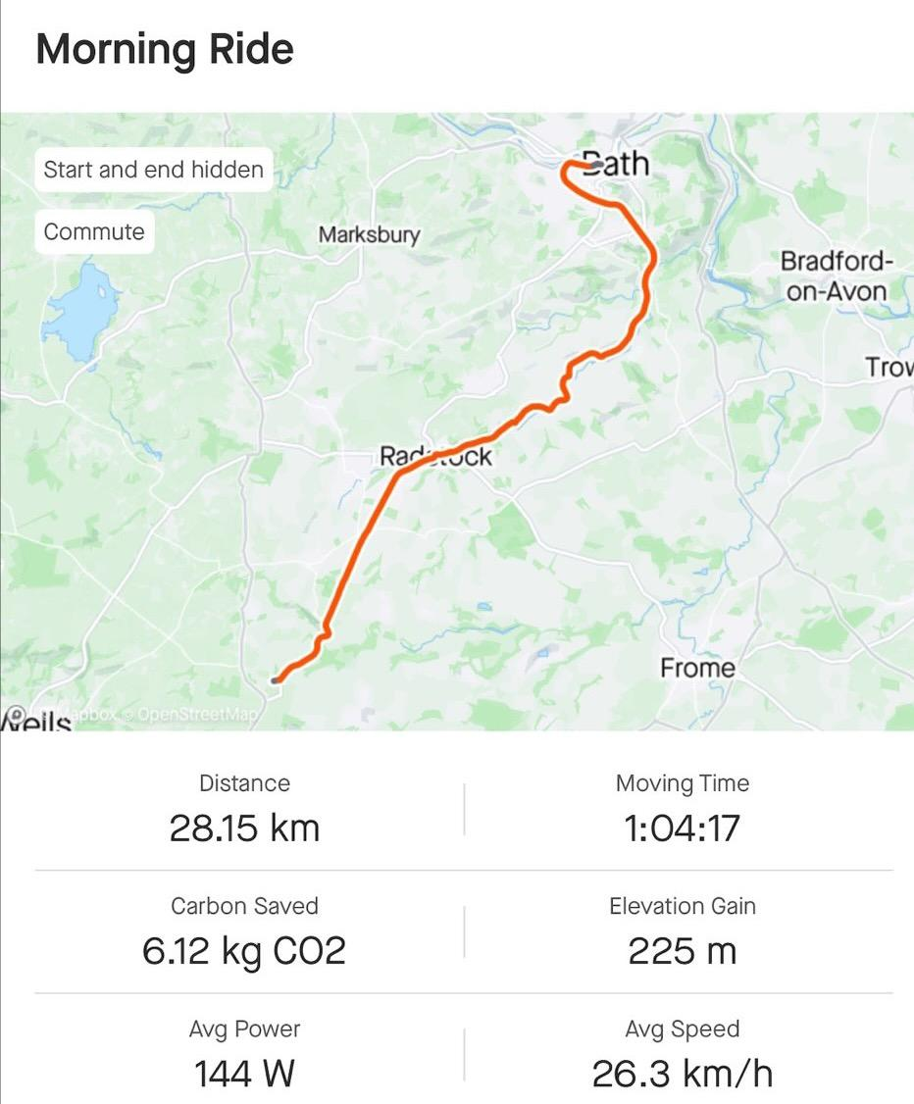
Related Examples for Sustainability
Train Tickets,
The train line, shows you how much CO2 you saved versus driving.
Strava,
Shows you how much CO2 you save when compared to driving for the distance of your activity

Slide 4
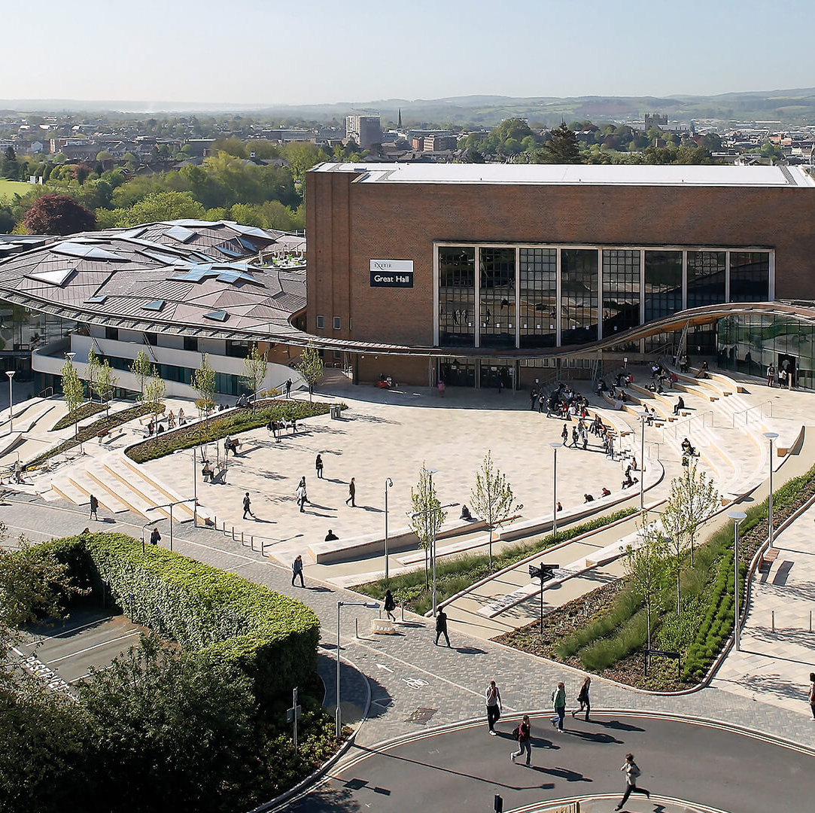
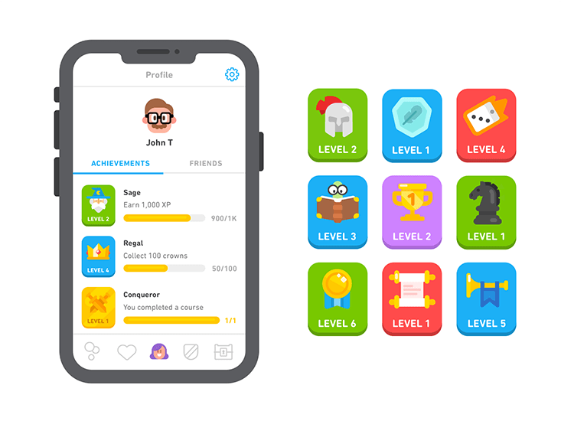
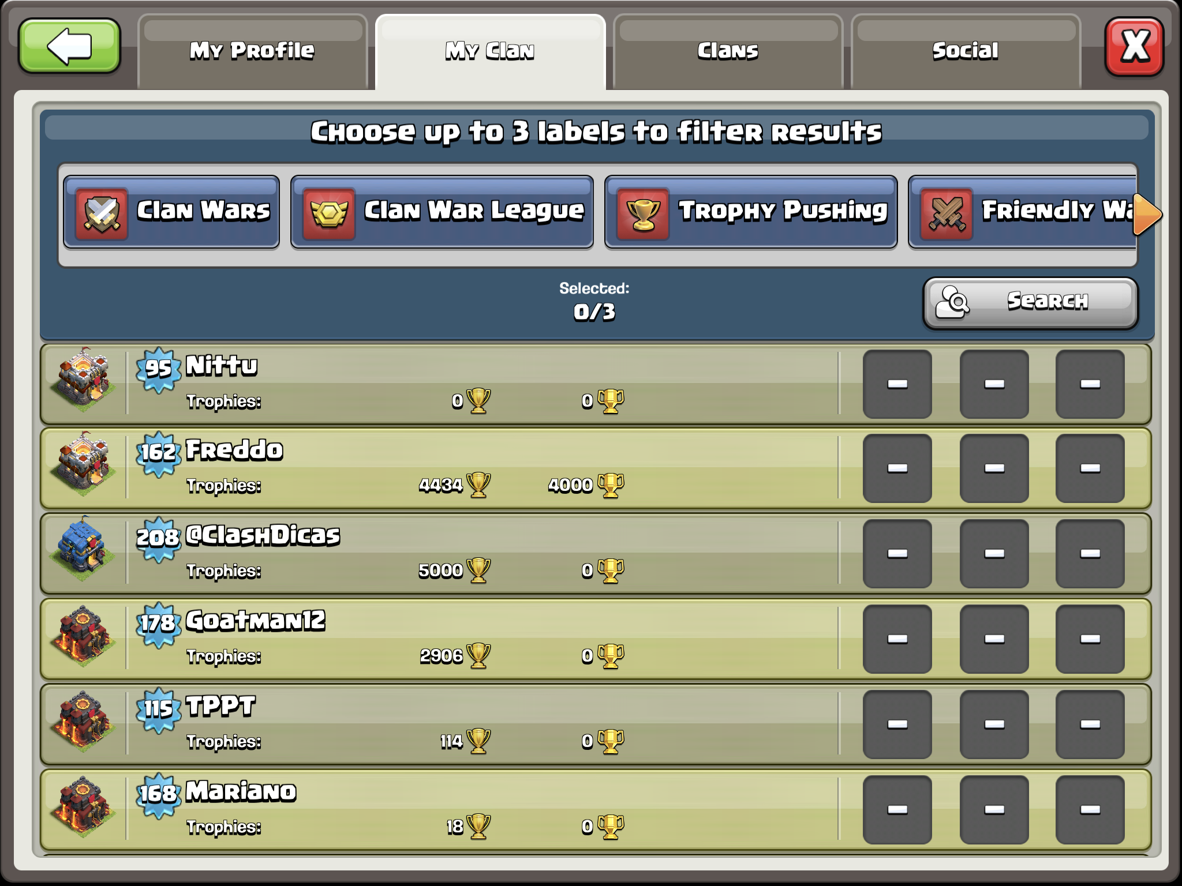
Related Examples for Gamification
For the Badge Collection
Duolingo
For leaderboards and Groups
Clash Of Clans

Slide 5

How Our Game Currently Works
Log a start and end location, with at least one of those being on campus.
Then you choose your mode of transport and log your CO2 savings.
Finally, you do this daily to compete with your friends and rival groups on leaderboards, collecting badges as you go.

Slide 6
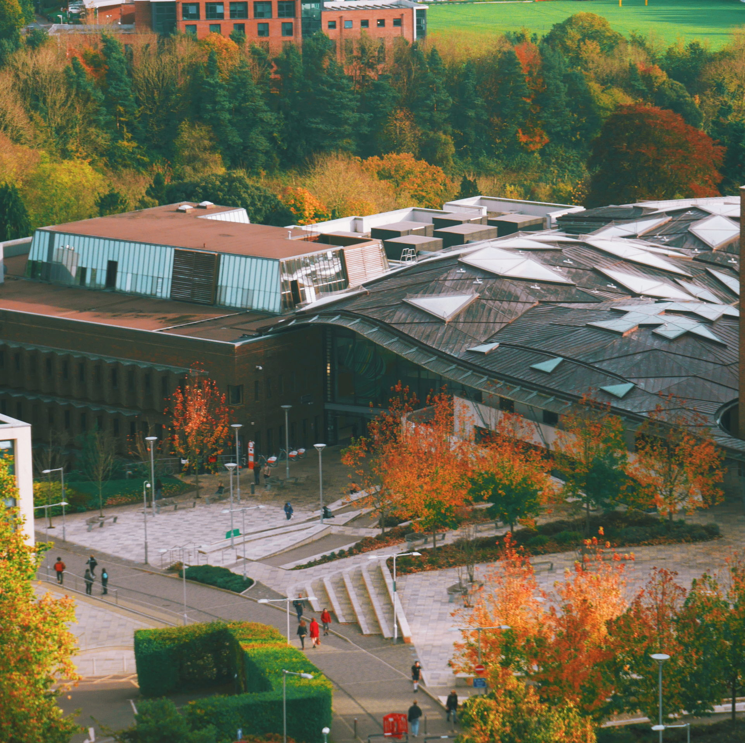
Where we Hope to Take the Game Next
On Campus Sustainability
More extensive groups and group events
Badges and levels to those badges
Displays such as maps and clearer metrics.

